Slide 1
STA130 T0209
Week 1: Data Visualization

Slide 2
Agenda
Introduction
Visualizations and Vocabulary list
Group discussion
Writing example
Short writing exercise

Slide 3
Introduction
L0201, Nathalie Moon, Monday 2-4pm
T0209, Vivian Ngo, Friday 2-4pm, AP124
TA: Vivian Ngo
Statistics Specialist, Mathematics Major
www.linkedin.com/in/vivian-ngo-a30bb5a8

Slide 4
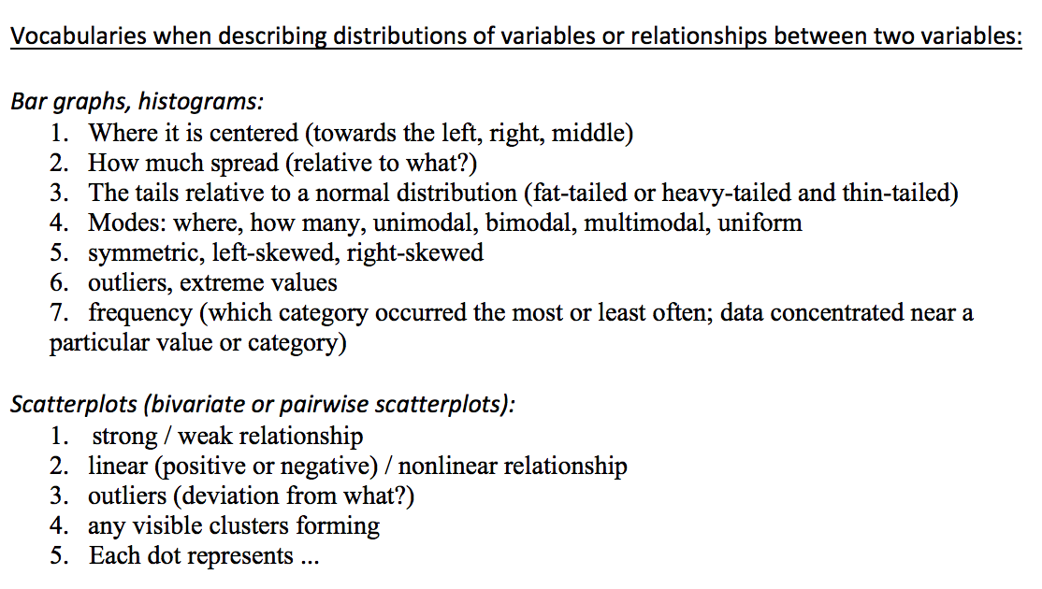
Visualizations and Vocabulary list

Slide 5
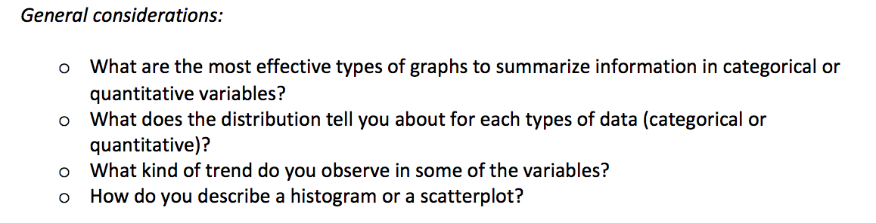
Visualizations and Vocabulary list

Slide 6
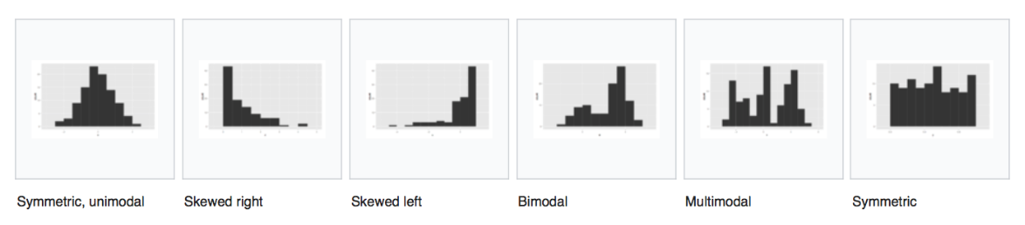
Visualizations and Vocabulary list

Slide 7
Visualizations and Vocabulary list

Slide 8
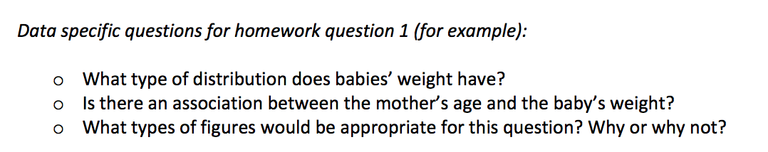
Visualizations and Vocabulary list

Slide 9
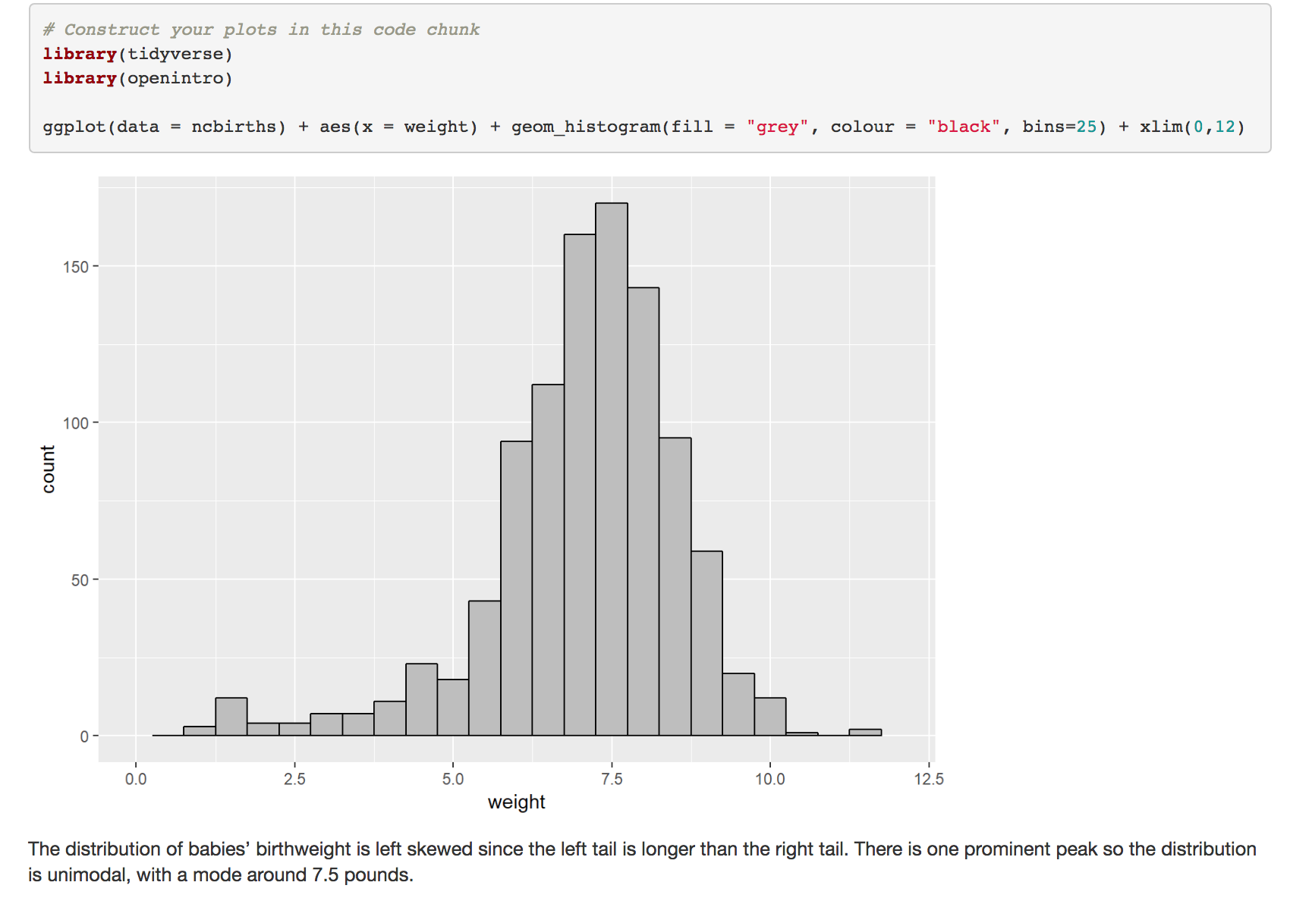

Slide 10
Baby’s birthweight is left skewed since the left tail is longer than the right tail. There is one prominent peak so the distribution is unimodal. The mode is around 7.5 pounds.

Slide 11
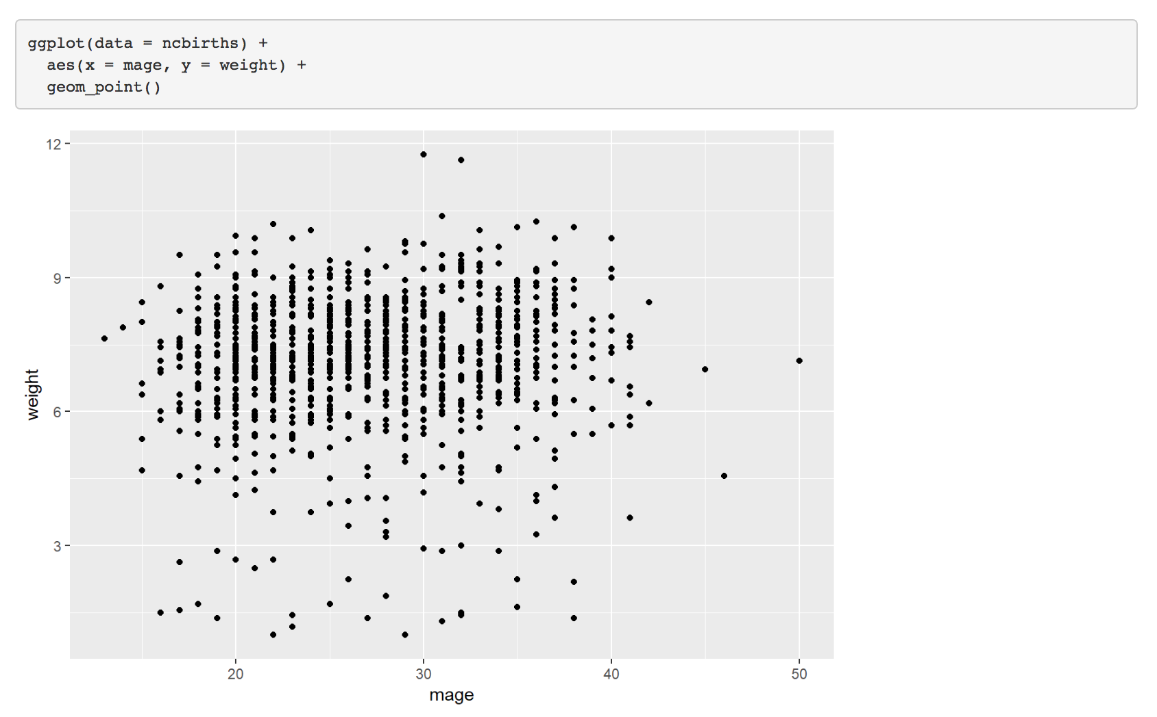

Slide 12
There is no strong association between the mother’s age and the baby’s weight. There is no obvious pattern in the dots which would suggest a relationship between these two variables.

Slide 13
Group Discussion
Homework Question #2
Describe what the graphs are telling us; i.e., what type of relationships do you notice between parents’ height and that of their children?
Come up with a “story” of your main results, use a few of your graphs (you can make ones not originally asked in the question, if it will help and is appropriate).
Explain what logical order is the most effective to tell their stories.
Tell the story to each other.

Slide 14
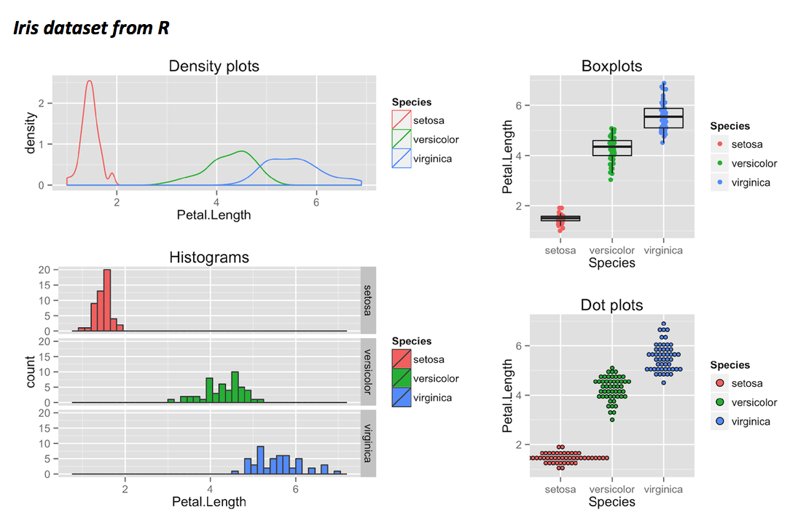
Writing example

Slide 15
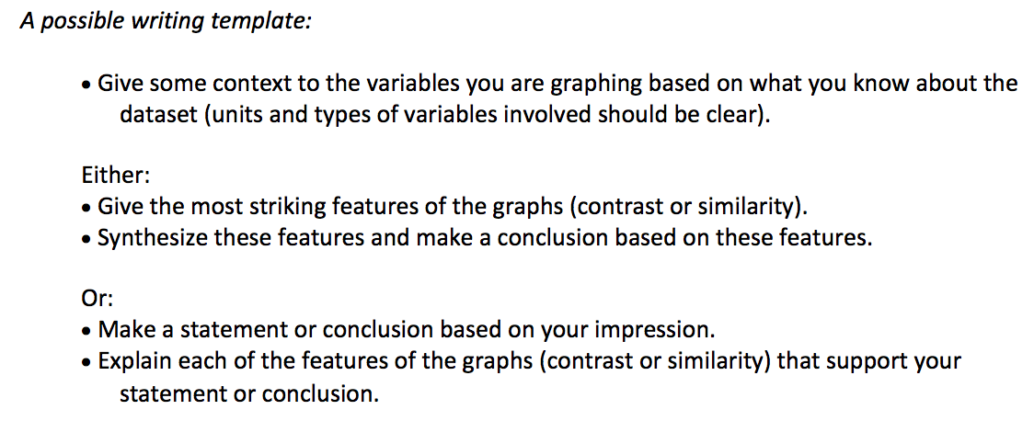
Writing example

Slide 16
Writing example #1
The petal length of Iris setosa distributes differently from Iris versicolor and Iris virginica. The density plot/histogram of petal length of Iris setosa has a sharp peak while the other two have a flatter distribution.

Slide 17
Writing example #2
We looked at the petal length of Iris. Specifically, Iris versicolor and Iris virginica, despite having different centres, have similar spread in terms of their petal length. Interestingly, the shape of distribution also differs between the species. We conclude that the petal length of Iris setosa, Iris versicolor and Iris virginica are different in terms of their centre, spread and shape.

Slide 18
Writing Example #3
The petal length in c.m. of 50 samples from each of three species of Iris (Iris setosa, Iris virginica and Iris versicolor) was investigated/examine/summarized. The graph suggested that distribution of petal length is species dependent. In particular, petal length of Iris setosa is shown to be less variable than Iris versicolor and Iris virginica. However, despite Iris versicolor having on average longer petals than Iris virginica, the range of petal length is similar for these two species. Further, the shape of distribution also differs according to species, with Iris setosa more or less symmetric about its centre, and versicolor and virginica skewed to the left and right, respectively.

Slide 19
Writing example #1
The petal length of Iris setosa distributes differently from Iris versicolor and Iris virginica. The density plot/histogram of petal length of Iris setosa has a sharp peak while the other two have a flatter distribution.
The context is missing and description of graphs is not specific and too vague (distributes differently in terms of what?). The most striking features of the graphs were not mentioned and the conclusion is missing or not supported by any statements. No transitions.

Slide 20
Writing example #2
We looked at the petal length of Iris. Specifically, Iris versicolor and Iris virginica, despite having different centres, have similar spread in terms of their petal length. Interestingly, the shape of distribution also differs between the species. We conclude that the petal length of Iris setosa, Iris versicolor and Iris virginica are different in terms of their centre, spread and shape.
There was some context, but the connection to all variables used was not clear.
The organization is logical and appropriate use of transitions.
The feature statements contain some information but too vague.
Descriptions of graphs somewhat support the conclusion.

Slide 21
Writing Example #3
The petal length in c.m. of 50 samples from each of three species of Iris (Iris setosa, Iris virginica and Iris versicolor) was investigated/examine/summarized. The graph suggested that distribution of petal length is species dependent. In particular, petal length of Iris setosa is shown to be less variable than Iris versicolor and Iris virginica. However, despite Iris versicolor having on average longer petals than Iris virginica, the range of petal length is similar for these two species. Further, the shape of distribution also differs according to species, with Iris setosa more or less symmetric about its centre, and versicolor and virginica skewed to the left and right, respectively.
Provided the context. The organization is logical. The feature statements are detailed and informative. Descriptions of graphs support the conclusion.

Slide 22
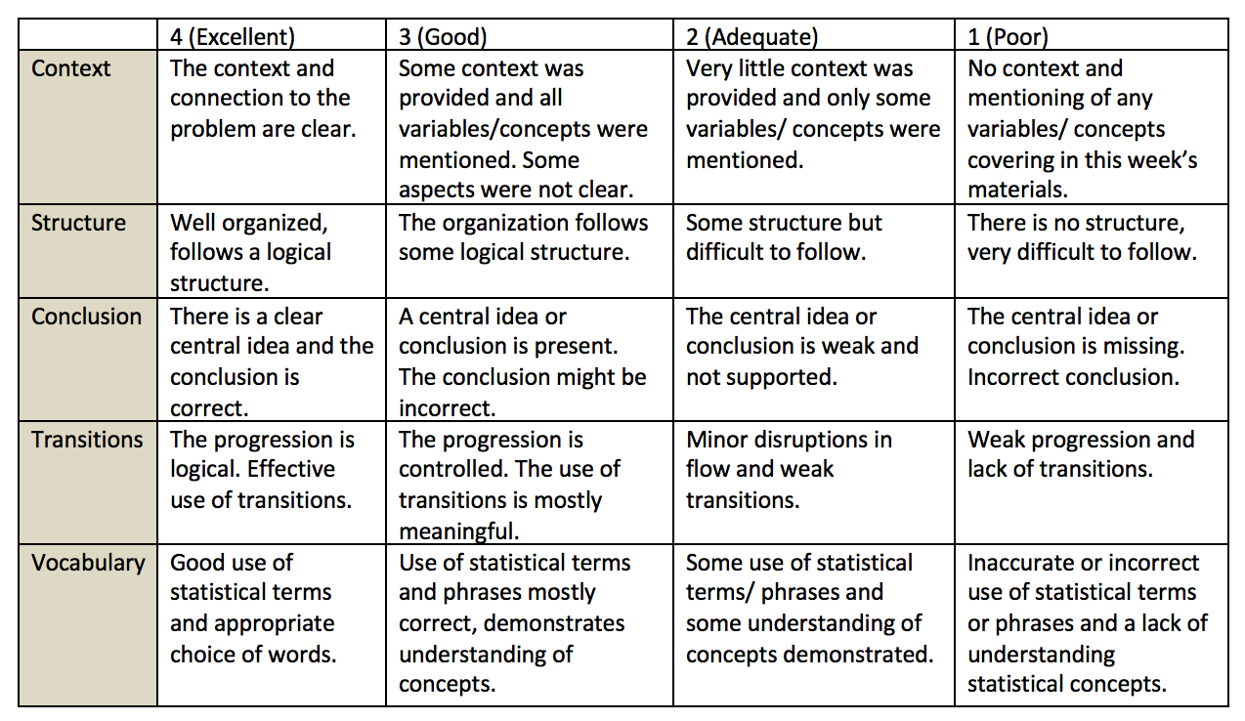
Short writing exercise
Write a short paragraph to describe coherently the graphs you produced and structure these graphs to tell a story. Use at least 3 graphs from question 2 to support the story.
Submit on Quercus

